Slide 1

Clinic Appointment & Prescription Manager
Team No
Jeyanth Vighnesh Roll No 2620080063
N Sai Maneesh Reddy Roll No 2620080084

Slide 2
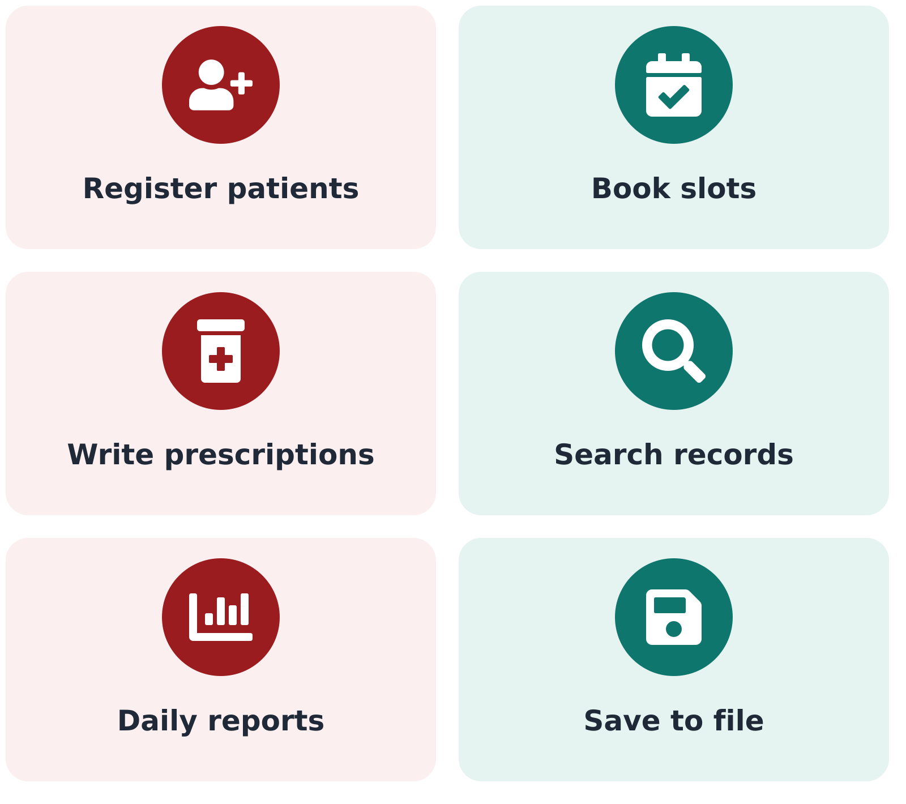
Abstract
Project: Clinic Appointment & Prescription Manager: a Java console application for small clinics.
Purpose: Replace paper registers with a program that books, cancels and tracks appointments.
Features: Register patients and doctors, book slots, write prescriptions, search records, generate daily reports.
Design: Object-oriented classes, input validation, custom exceptions and CSV file storage.
Techniques: Collections, lambdas and Streams to filter, sort and summarize data.

Slide 3
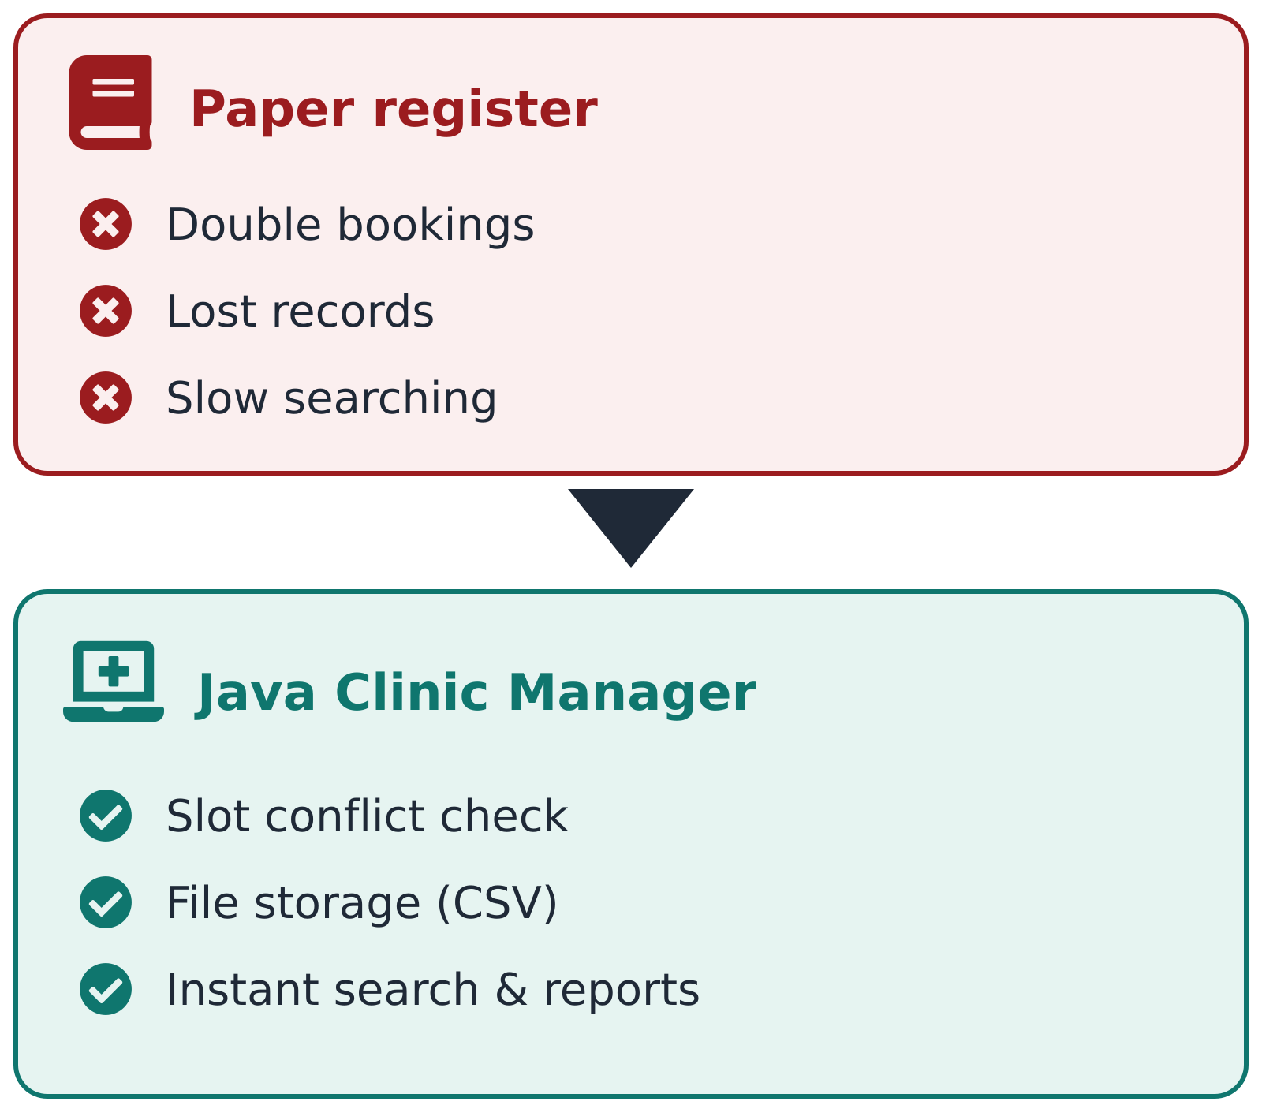
Understanding Problem Statement
Problem: Clinics track appointments and prescriptions manually, causing double bookings, lost records and slow lookups.
Need: A reliable program to store patients, doctors, appointments and prescriptions, and to prevent clashes.
Inputs: Patient details, doctor, date and time slot, diagnosis and medicines.
Outputs: Booking confirmation, prescription slip, patient history and daily summary report.
Challenges: Slot conflicts, invalid input, missing or corrupt data files, fast searching and sorting.

Slide 4
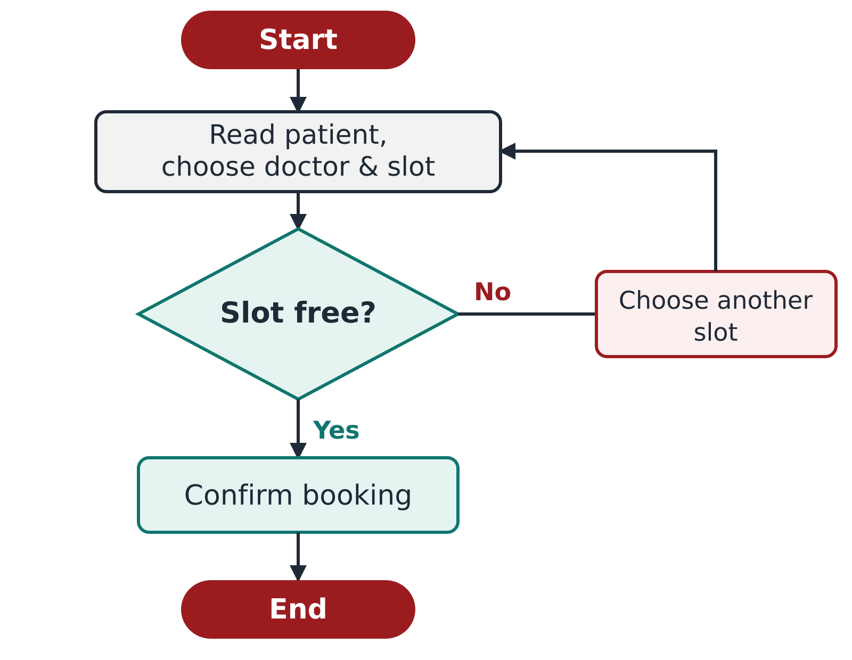
CO 1: Problem to Program
Module 1
Algorithm: Steps: read patient, choose doctor and slot, check availability, confirm booking
Flowchart: Booking flow with decision "Slot free?" (Yes: confirm, No: choose another)
Data types: int patientId, double fee, String name, boolean isBooked, char gender
Constants: final double CONSULT_FEE; final int MAX_SLOTS
Operators: Arithmetic for bill total; relational/logical for checks; ternary for status
Typecasting: (int) conversion when computing age or rounding fees
Console I/O: Scanner for input; printf for formatted appointment table

Slide 5
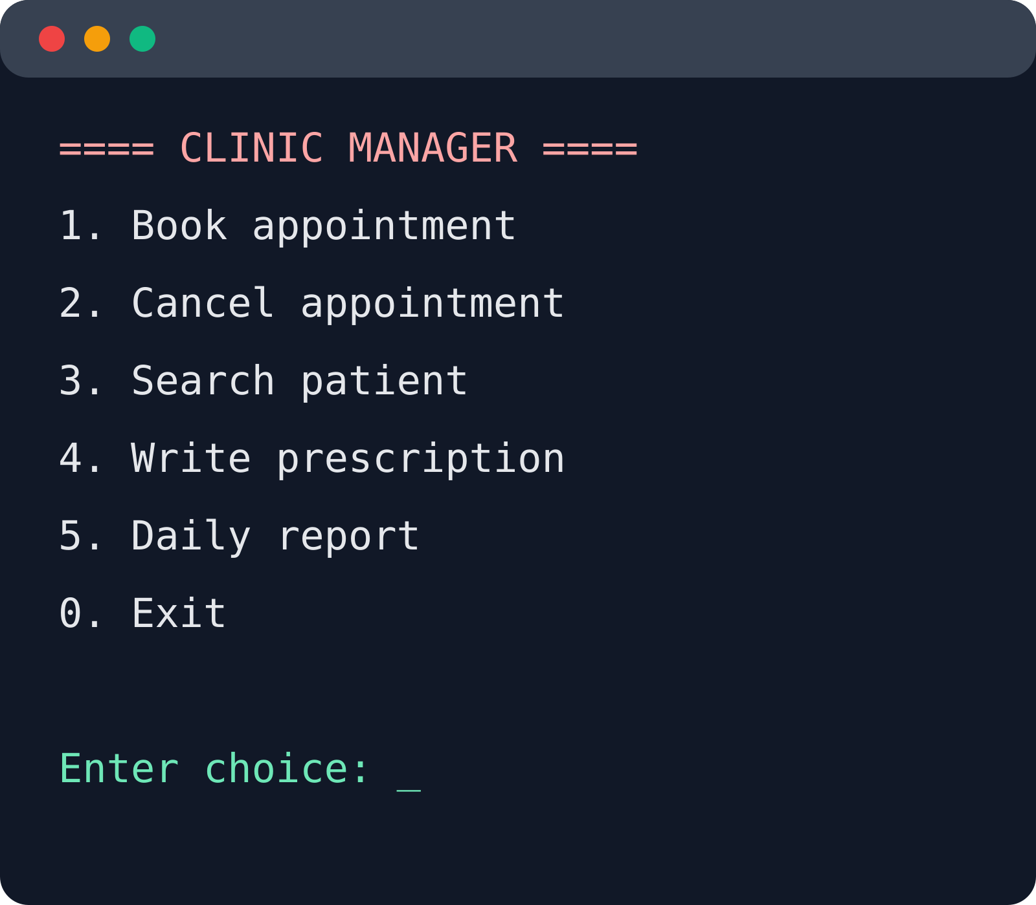
CO 2: Control Flow
Module 2
Menu: switch: 1 Book, 2 Cancel, 3 Search, 4 Prescribe, 5 Report, 0 Exit
Main loop: do-while keeps the menu running until the user exits
Validation: if / else-if ladder: age range, valid slot, non-empty name
Listing: for loop prints all appointments for a doctor
Search: while loop with break when the patient is found
Skipping: continue to ignore cancelled appointments in reports
Nested loops: Doctor-by-slot timetable printout

Slide 6
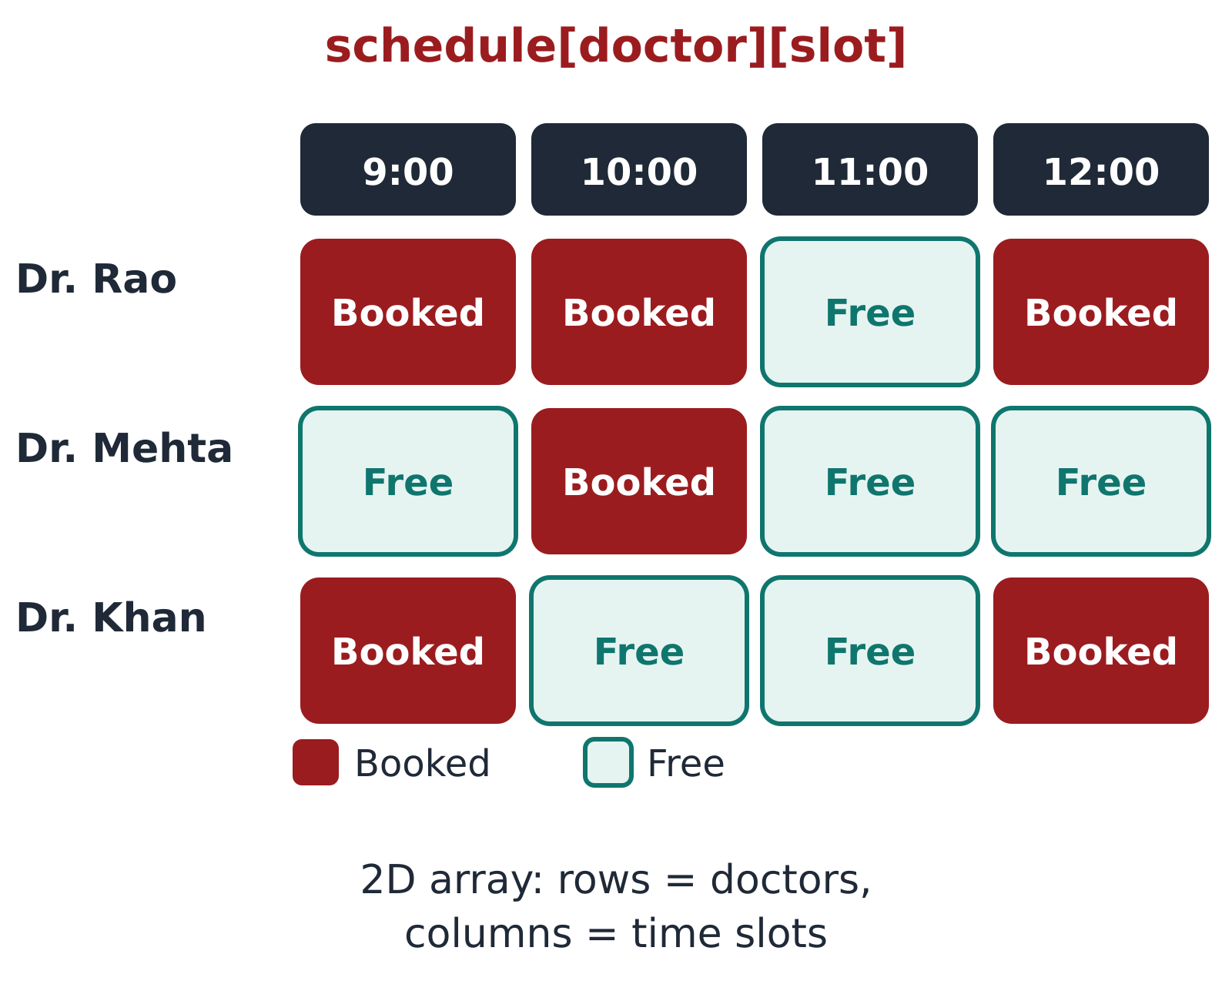
CO 3: Methods & Arrays
Module 3
Methods: bookAppointment(), cancelAppointment(), printBill(), isSlotFree()
Parameters: Pass patient and slot; return boolean success or double fee
Overloading: searchPatient(int id) and searchPatient(String name)
Recursion: Recursive binary search over sorted patient IDs; recursive total of fees
1D arrays: Array of fees: sum, average, highest, count of appointments per day
2D array: Weekly schedule grid [doctor][slot] marking booked or free
for-each: Print every medicine in a prescription

Slide 7
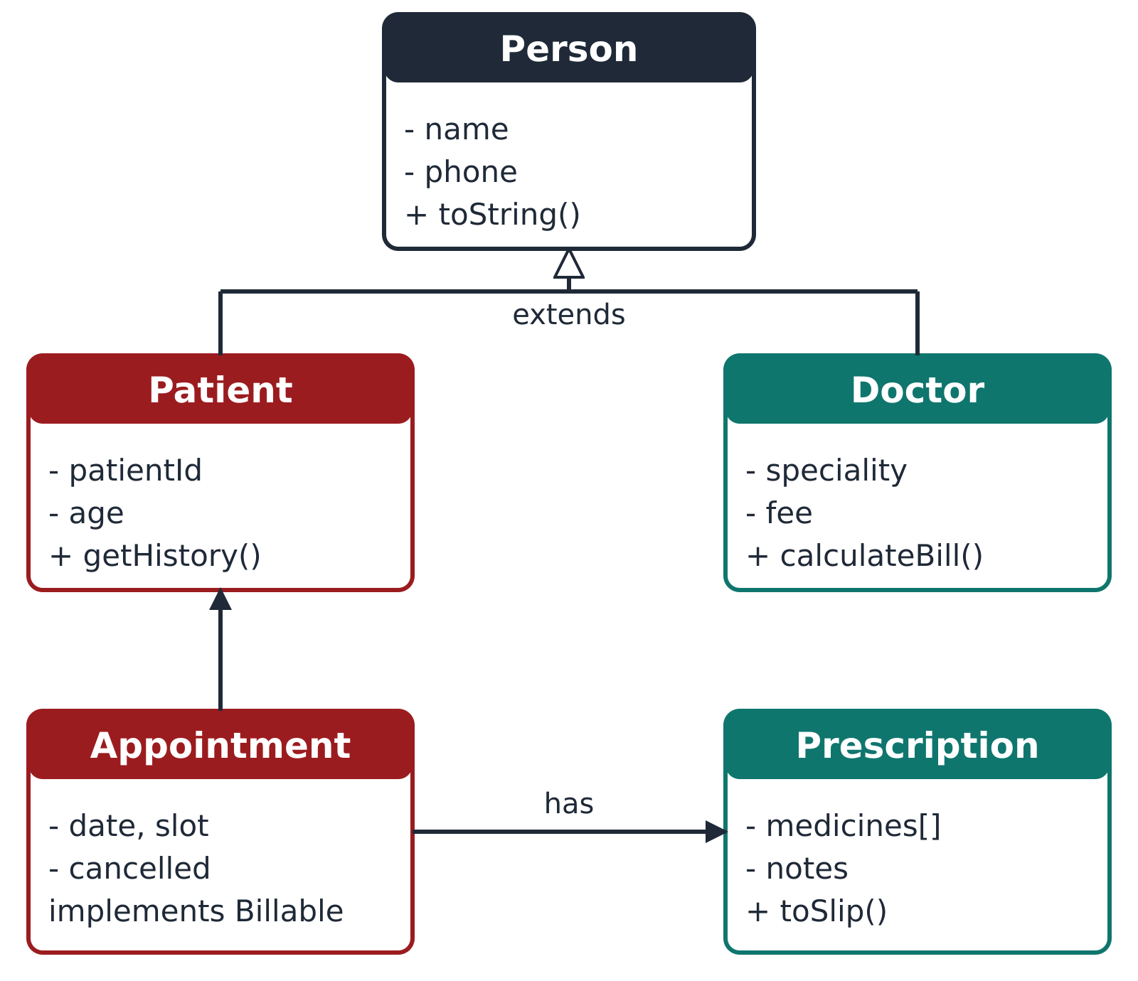
CO 4: OOP & Exceptions
Module 4
Classes: Patient, Doctor, Appointment, Prescription; objects created with new
Constructors: Default and parameterized; overloaded; this for field names
Encapsulation: Private fields with getters/setters; hidden internal data
Static: static int nextId for auto IDs; static constants for fees
Inheritance: Person is the parent of Patient and Doctor; method overriding
Interface: Billable with calculateBill(); toString() for readable output
Exceptions: Custom SlotUnavailableException; try-catch-finally, multi-catch, throw, throws

Slide 8
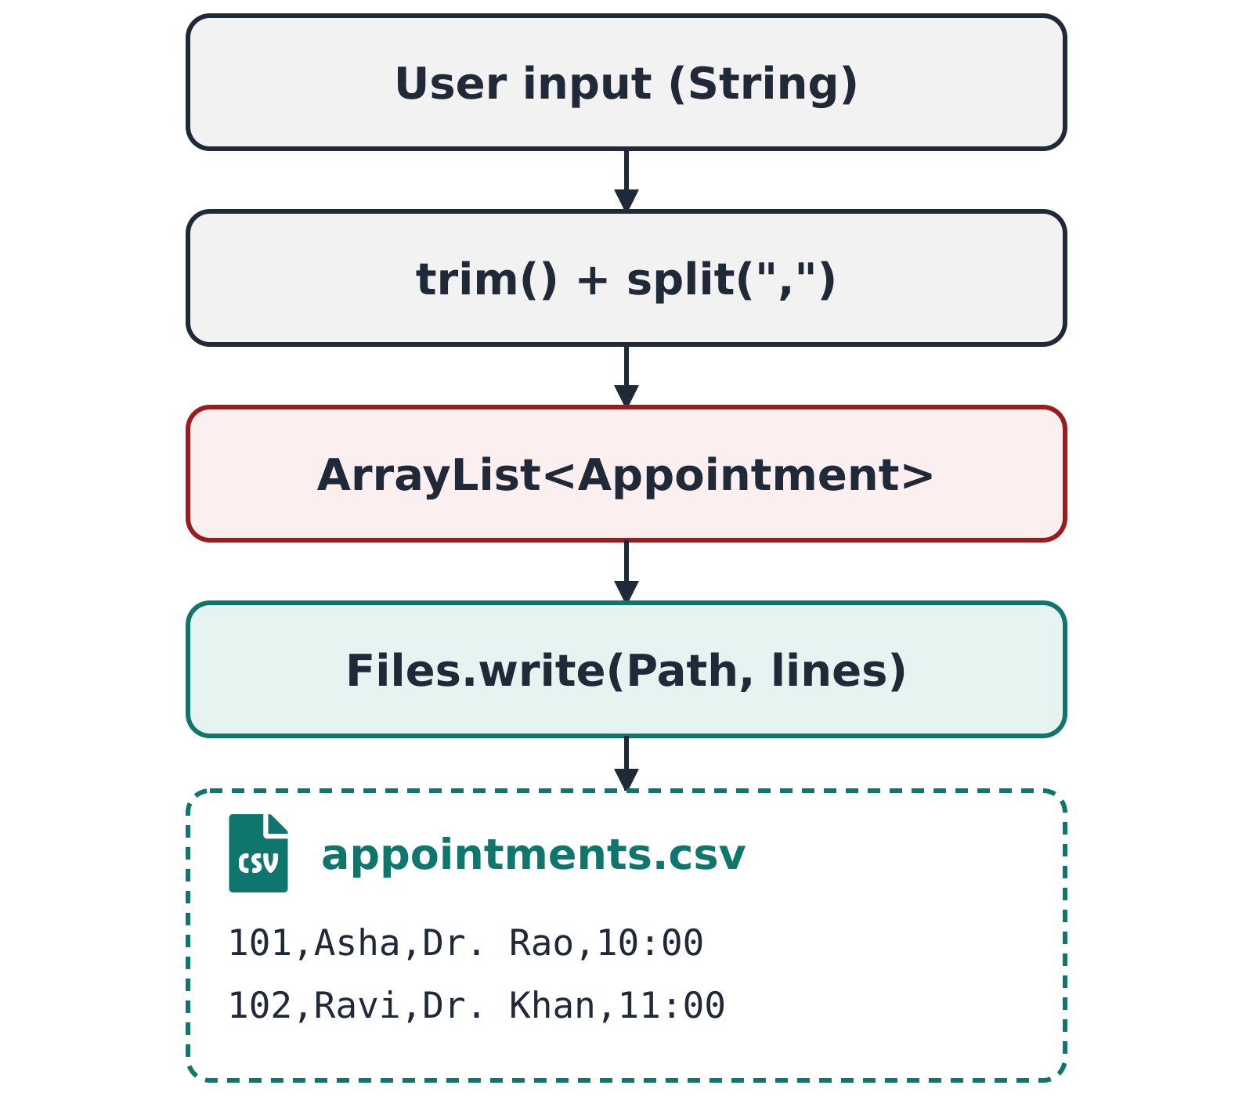
CO 5: Strings & File I/O
Module 5
Strings: Validate phone and name; trim, toLowerCase, substring, equals() vs ==
StringBuilder: Build the prescription slip line by line
Parsing: split(",") to read CSV records; join() to write them
Sorting: Arrays.sort / Collections.sort with a Comparator by date or doctor
Searching: Arrays.binarySearch on sorted IDs
Saving: Files and Path: write appointments.csv, append new bookings
Loading: Read line by line; skip malformed records; handle missing file
Safety: try-with-resources closes readers and writers automatically

Slide 9
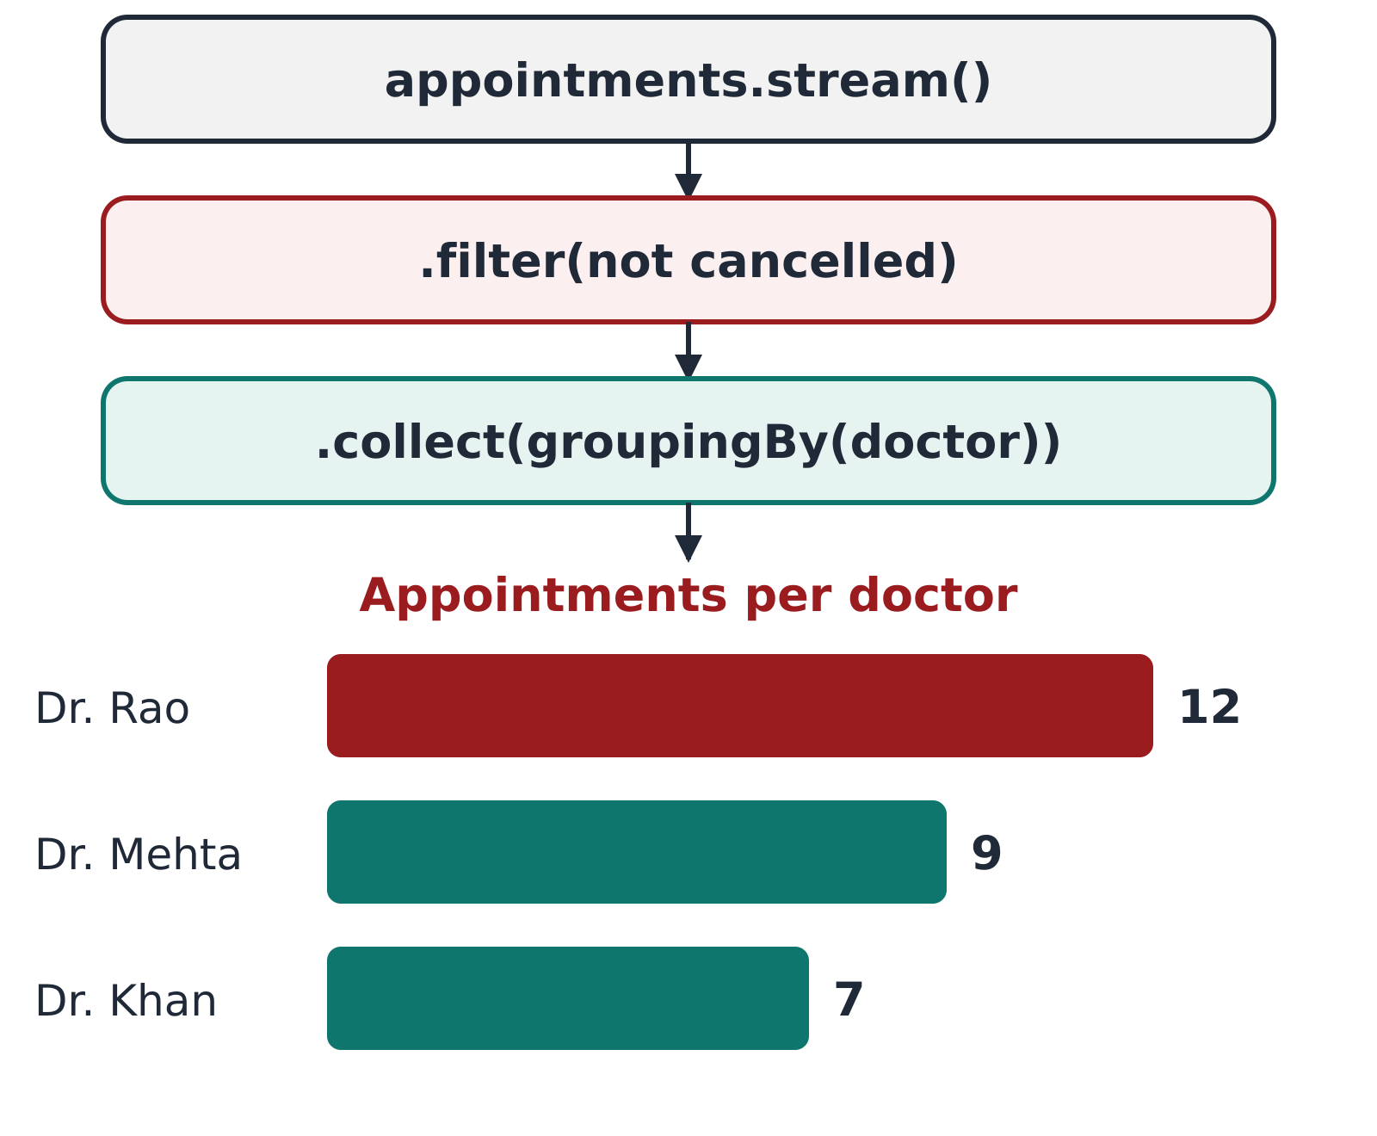
CO 6: Collections & Streams
Module 6
Lists: ArrayList<Appointment> holds all bookings
Maps: HashMap<Integer, Patient> for fast lookup by ID
Sets: HashSet of booked slots to stop double booking
Generics: Typed collections avoid casting errors
Lambdas: Predicate to filter by doctor or date; Comparator to sort
Streams: filter, map, sorted, distinct, limit; count, collect, reduce
Collectors: groupingBy doctor with counting; joining medicine names
Report: Read file lines as a stream and print the daily summary

Slide 10
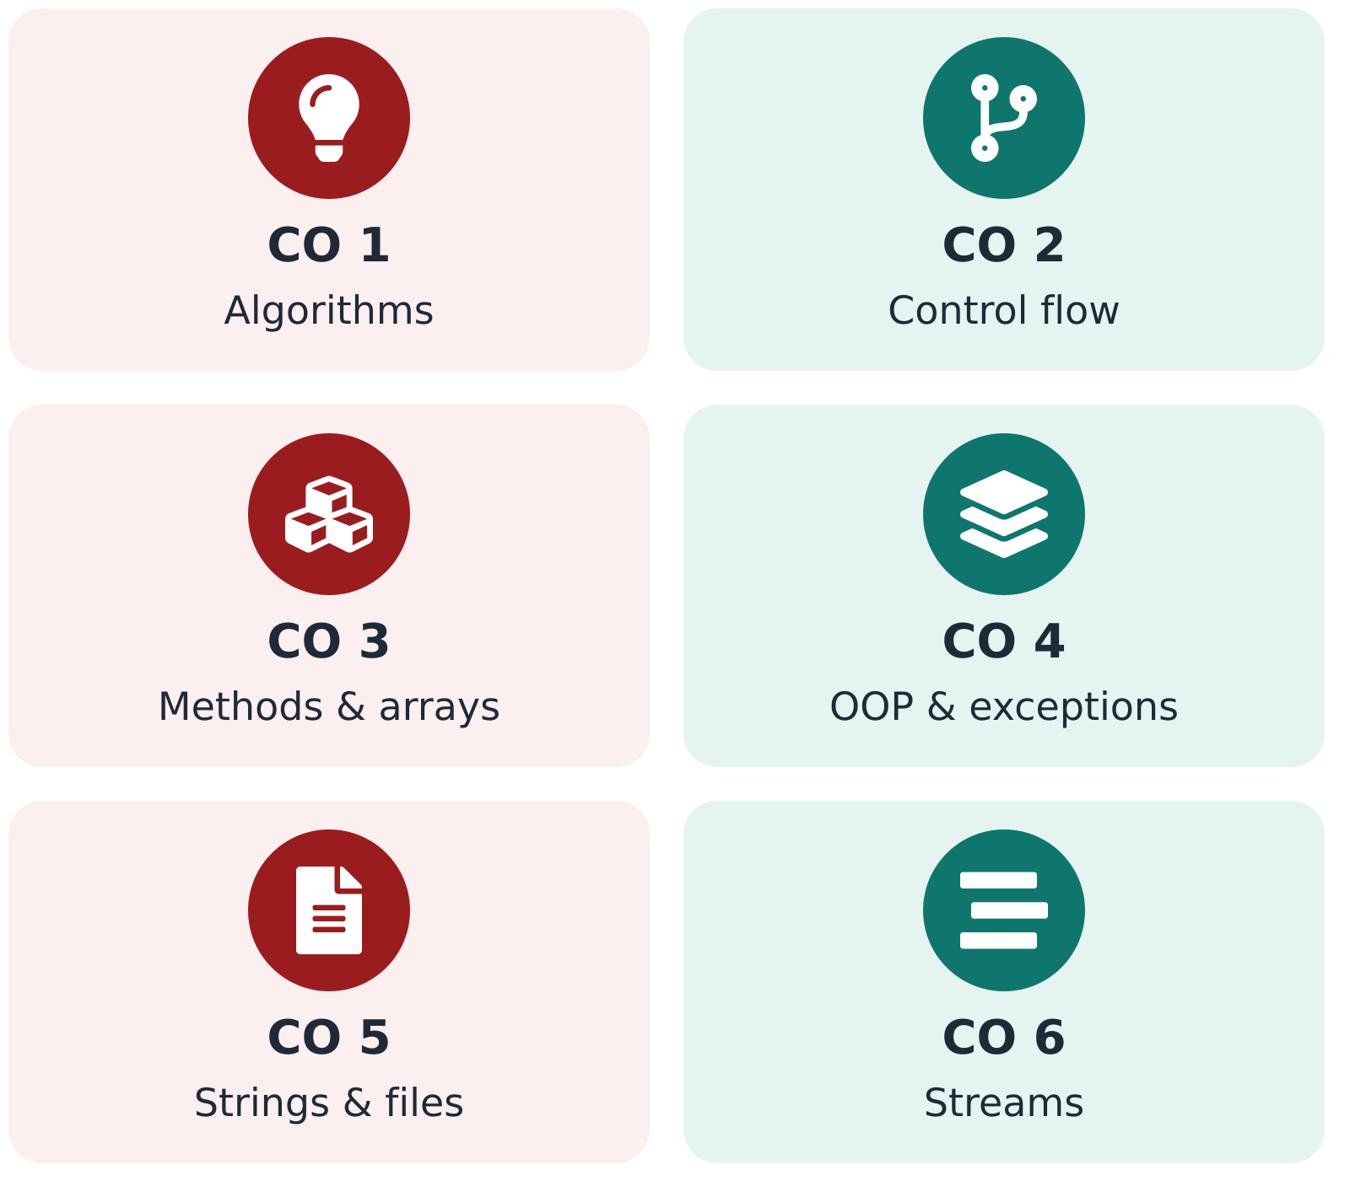
Conclusion
Result: A working Clinic Appointment & Prescription Manager in Java.
CO 1-2: Algorithm design, console I/O and menu-driven control flow.
CO 3: Reusable methods, recursion and arrays for schedules.
CO 4: OOP model with encapsulation, inheritance and custom exceptions.
CO 5-6: File storage, sorting, collections and stream-based reports.
Future work: GUI or web front end, database storage, SMS reminders.

Slide 11
Screen Shots
Daily report: appointments per doctor
Map<String, Long> perDoctor = appointments.stream()
.filter(a -> !a.isCancelled())
.collect(Collectors.groupingBy(
Appointment::getDoctorName,
Collectors.counting()));
perDoctor.forEach((d, c) ->
System.out.printf("%-12s %d%n", d, c));
Sample output
Dr. Rao 12
Dr. Mehta 9
Dr. Khan 7
Replace this box with screenshots of your project: booking menu, prescription slip and the daily report.

Slide 12
Geo Tag Photo and git hub link
Geo-tagged photo
Insert your geo-tagged photo here
GitHub repository
Paste your repository link here

